Slide 1




Biography
Alejandro Giraldo Hererra

Slide 2
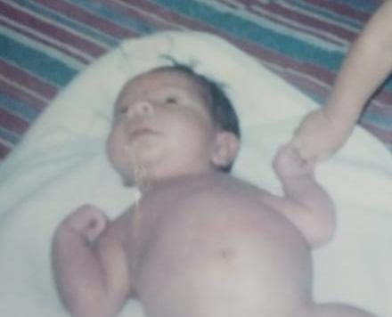
I was born on the 23th of March, 2003 in San Juan De Dios, Armenia – Quindío

Slide 3
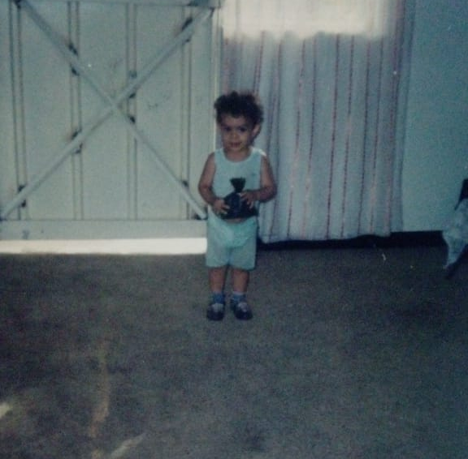
I went to Isabella’s Kindergarten in 2006

Slide 4
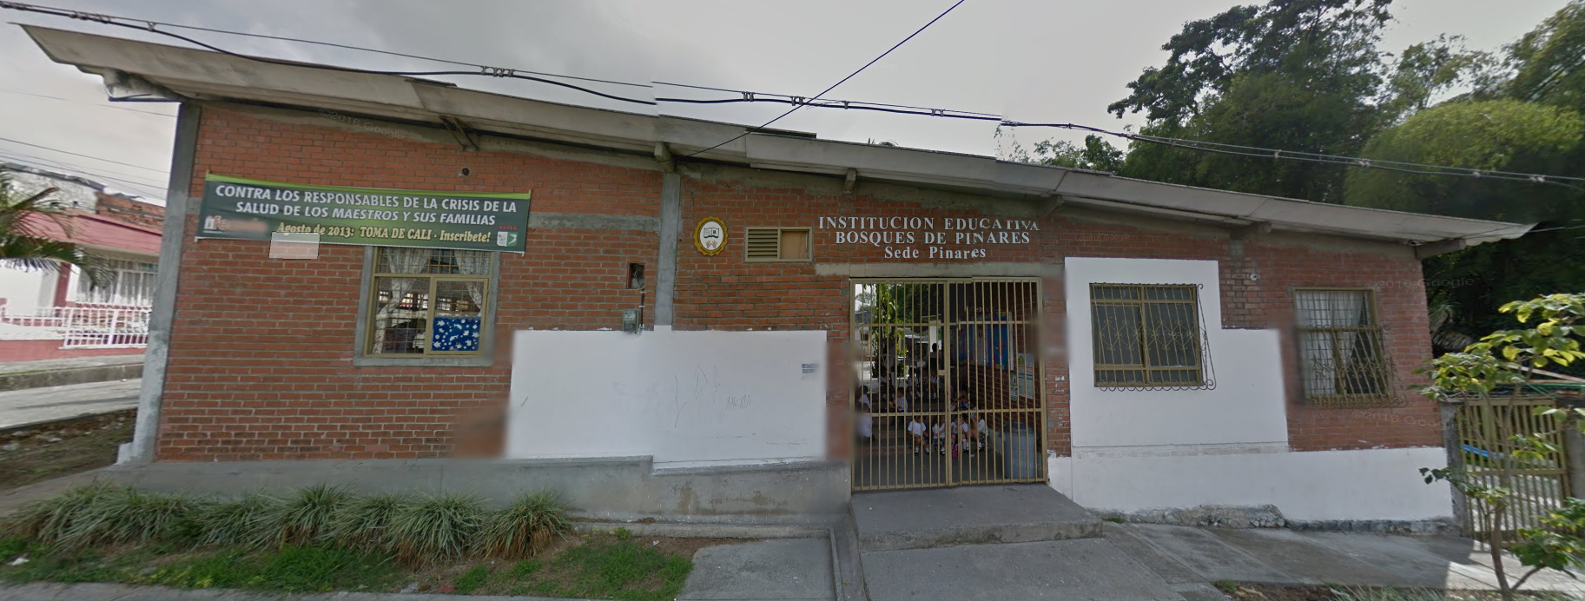
I went to Bosques de Pinares Primary School at 2008

Slide 5
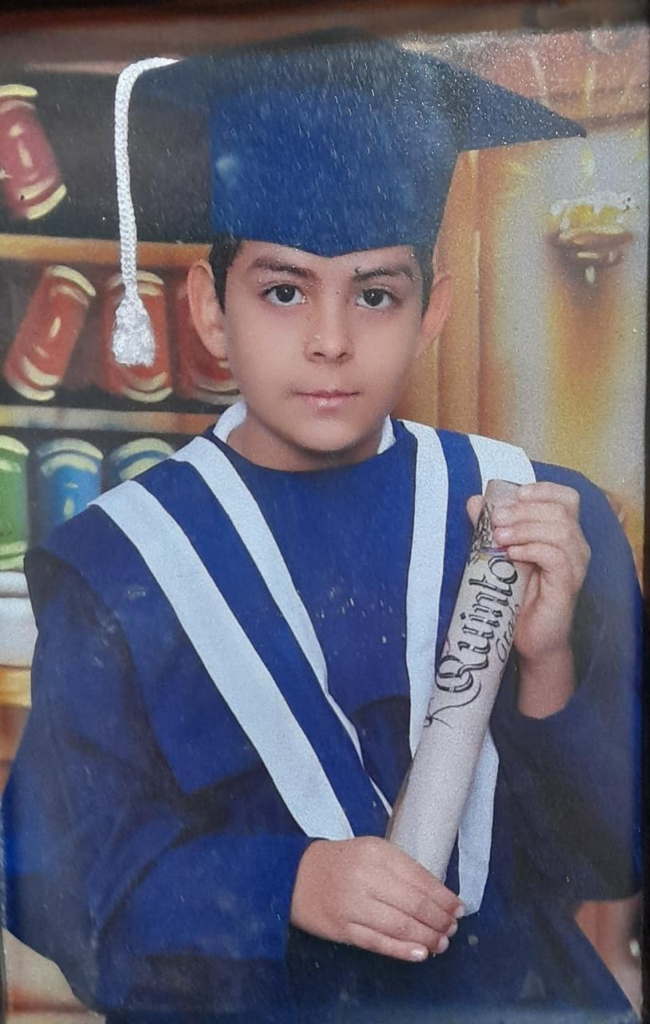
I graduated from Primary School on November 2013

Slide 6
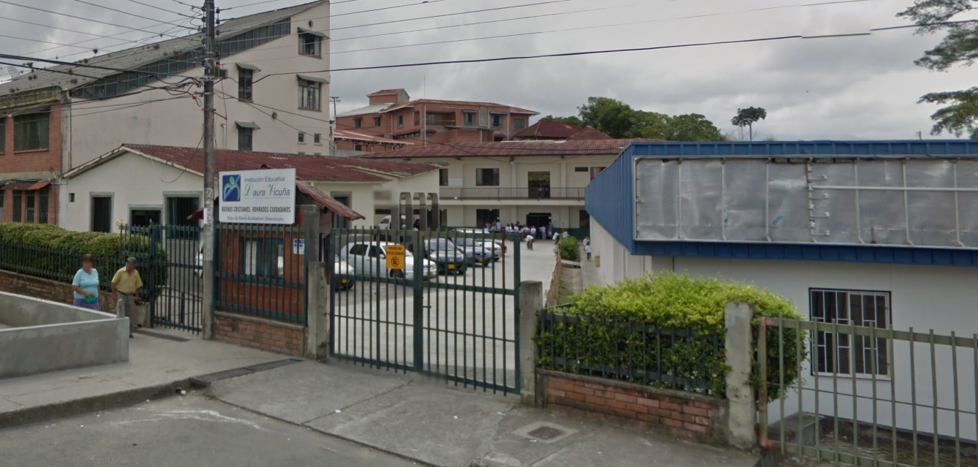
I started studying at Laura’s Vicuña School in 2014

Slide 7
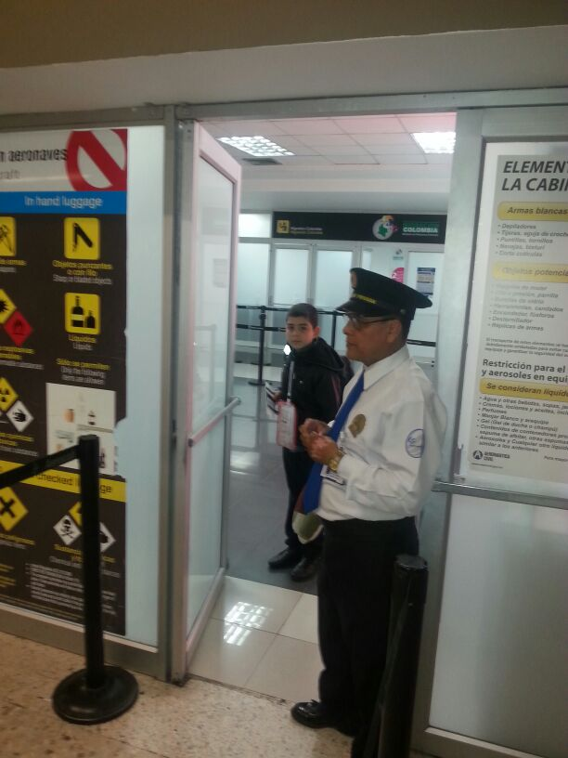
I went to Spain at 2016

Slide 8
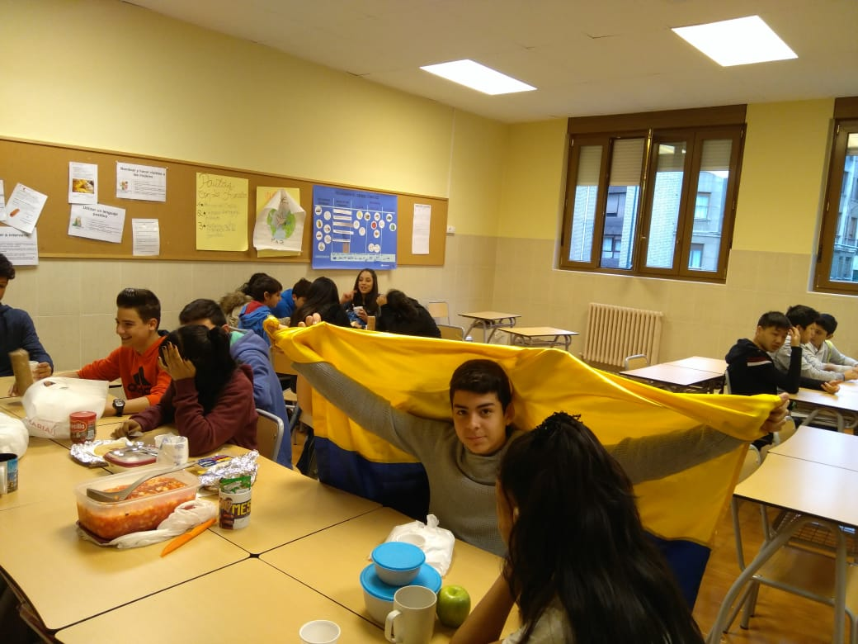
I studied 2 years in Spain.

Slide 9
I returned to Colombia at 2018

Slide 10
One of my software projects was one of the best in Quindío at 2019

Slide 11
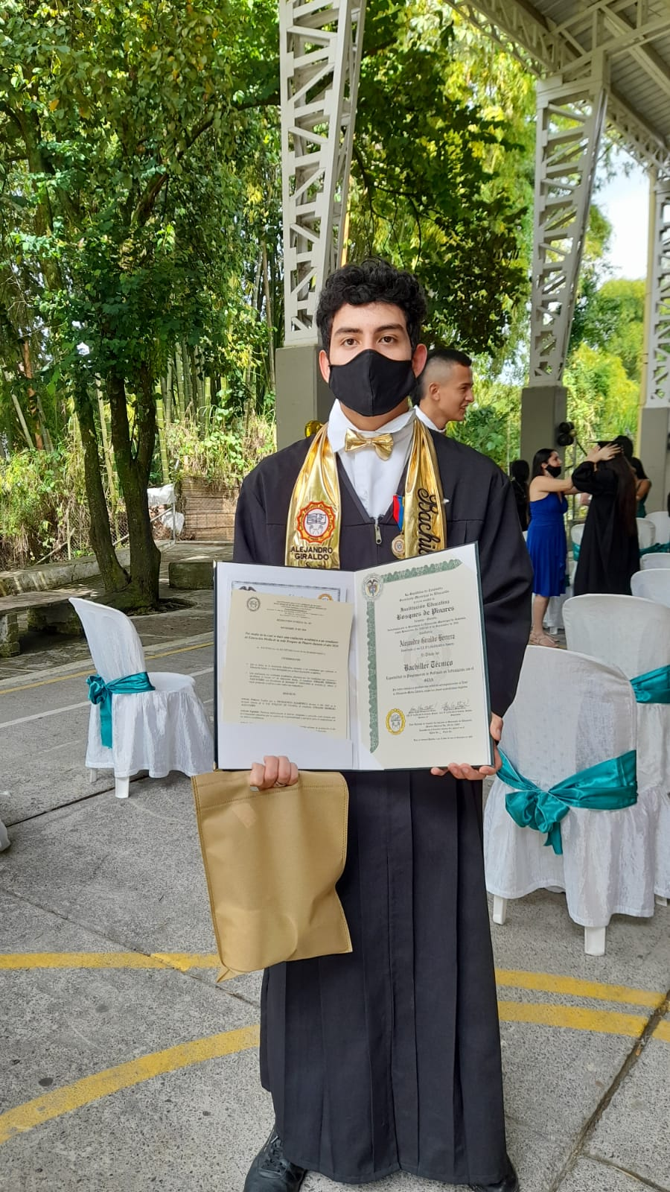
I finished high school in Colombia at 2020

Slide 12

I won a scholarship in 2020

Slide 13
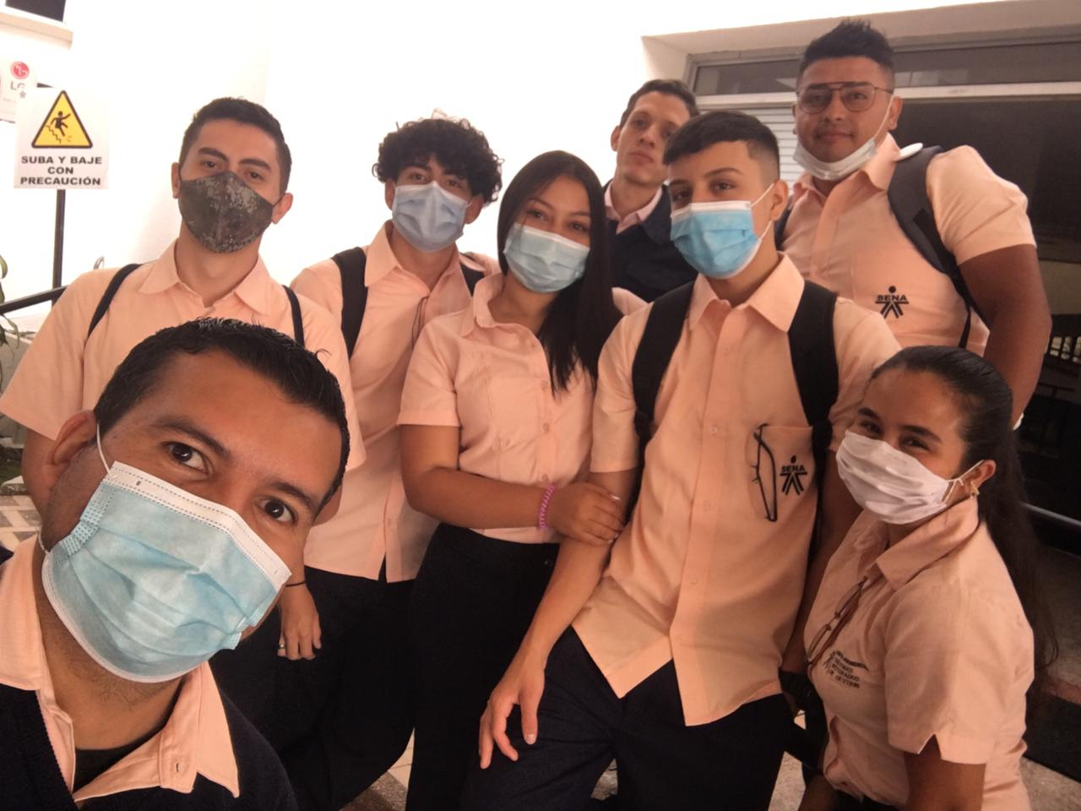
I started in SENA at 2021

Slide 14
…

